Slide 1
Kaiser Permanente – Lambda Reference Architecture
December 18th 2019

Slide 2
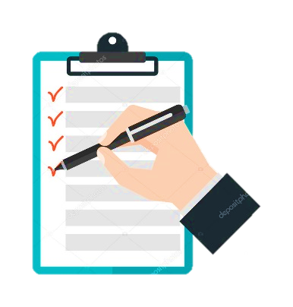
Agenda
01
Lambda architecture - overview
02
Patterns & Principles of Lambda architecture
03
Azure Lambda architecture
04
Azure Lambda architecture with Change Feed
05
Potential use case in Healthcare
06
Key takeaways
07
Appendix

Slide 3
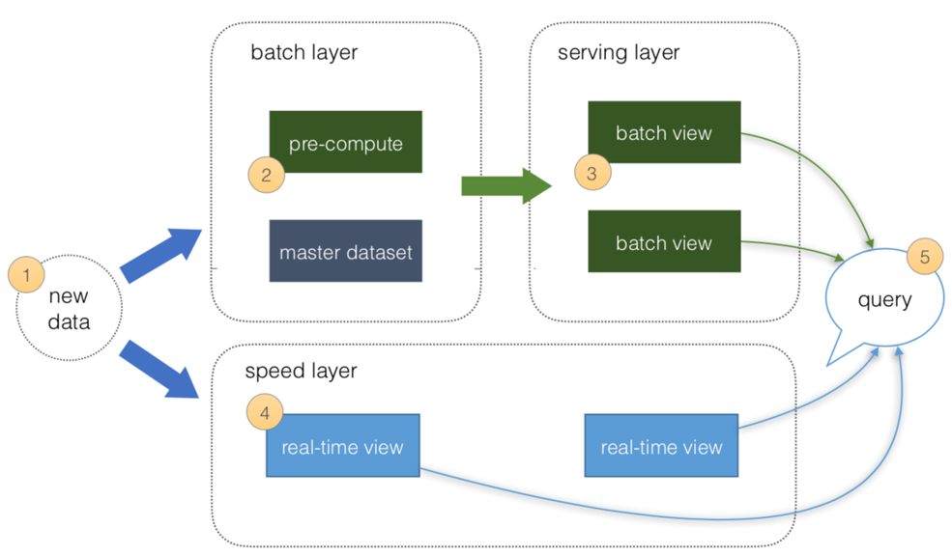
Lambda Architecture
Lambda Architecture -
As batch windows shrink and data size grows, the simplest solution is to add commodity hardware to a compute cluster. However, these systems come with significant complexity. It is in this context that the Lambda Architecture shows its value
Handles massive quantities of data by leveraging both batch and stream-processing
Mitigates latencies of batch processing
Comprised of a data model (master dataset) with an append-only, immutable data source and a set of layers – batch layer, speed layer and serving layer
Batch layer - manages the master dataset and pre-compute batch views
Speed layer - processes data streams in real-time. It fills the "gap" caused by the batch layer
Serving layer – quickly responds to consumer requests
Query = λ (Complete data) = λ (live streaming data) * λ (Stored data)
Applications of Lambda Architecture
Lambda architecture is a good candidate for data processing enterprise models where:
User requests need to be served on ad-hoc basis using the immutable data storage.
Quick responses are required and system should be capable of handling various updates in the form of new data streams.
Stored records shall be preserved and addition of updates and new data is allowed.
Advantages of Lambda Architecture
Fault tolerant to machines failure and human mistakes
The batch and real-time views can be always recomputed from the master dataset
Low latency of reads and updates
Scalability - all layers can be scaled independently

Slide 4
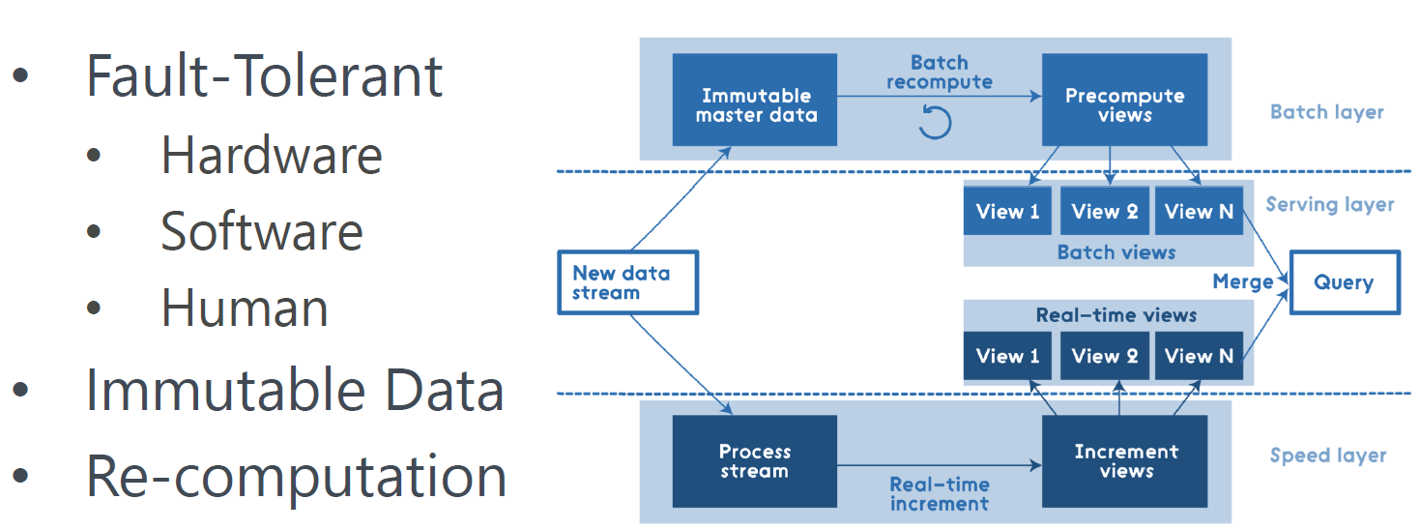
Patterns & Principles of Lambda Architecture
This architecture is comprised of an immutable, append-only dataset and three layers – batch layer, speed layer and serving layer
All data entering the system is dispatched to both the batch layer and the speed layer for processing
The batch layer manages the master dataset, an immutable, append-only set of raw data and pre-computes the batch views
The speed layer compensates for the high latency of updates to the serving layer and provides real-time views
The serving layer combines batch view and real-time views to give results in real-time for any ad-hoc query over all data
Bottom line: lambda architecture is query=function(over all data)
Principles of Lambda architecture
Dependent on data principles of append-only, immutable, and atomic
Balance latency, throughput, and fault-tolerance
Correlate with the growth of big data and real-time analytics
Mitigate latencies of batch processing
Handle massive quantities of data by leveraging both batch and stream-processing

Slide 5


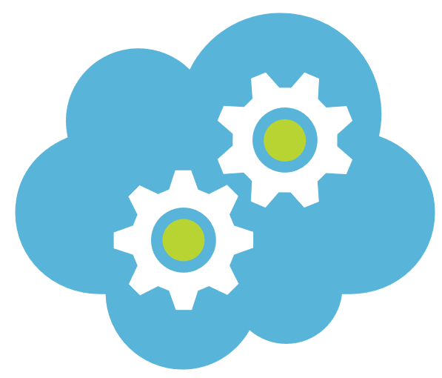
Azure Lambda Architecture
The Azure Lambda Architecture is identical to the reference Lambda architecture
Data Source(s)
Batch Layer
Serving Layer
Encounter
Pre- compute Views
Batch View
Data Ingestion Service
Lab
Master data
Batch View
Decision Layer
Pharmacy
Speed Layer
Membership
Real-time Data
Real-time View
Billing
Advantages of Azure Lambda Architecture
Security – no compromise on the data security ; provides security for both data in rest and flight
Flexibility – You can use open source capabilities such as spark , hive , Sqoop etc. on Azure
Supportability – supports heterogeneous platforms based devices, protocols, and industry standards
Reliability – SLA based guaranteed performance

Slide 6
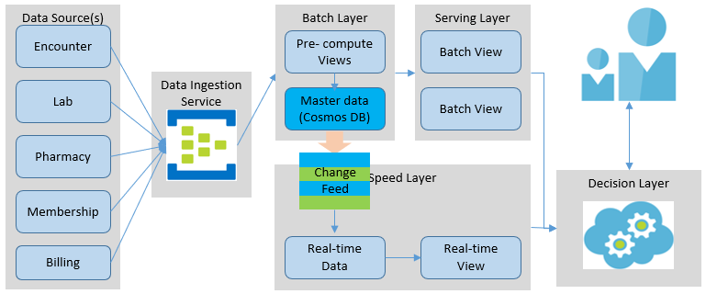
Azure Lambda Architecture with Change Feed
It is an evolution of the original Azure Lambda Architecture.
The data ingestion service is built for high volume and high frequency transaction scenarios.
All data is pushed only into Azure Cosmos DB
Cosmos DB serves as the master data (immutable, append-only) repository. Also:
Built for high velocity and high volume data operations
Change feed is enabled by default
Automatic Change Feed generation is guaranteed
The speed layer reads the Change Feed to create Real-time views
The Decision Layer minimizes query logic complexity
This architecture requires minimum custom development
Business Benefits
React in real-time to the changing business / market scenarios
Informed decisions , ensure high level of services uptime and customer satisfaction
Ad-hoc or exploratory data discovery for true value based payment models
Critical decision making in real-time such as, encounters, EMS, labs, benefits, billings, memberships.
Cosmos DB
Service guaranteed - high availability, minimal latency, and comprehensive SLAs
Provides automatic data maneuvering through Change Feed
Change Feed
Automatically enabled in any Cosmos DB database account
Doesn’t need any additional configuration to start working

Slide 7

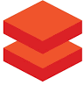
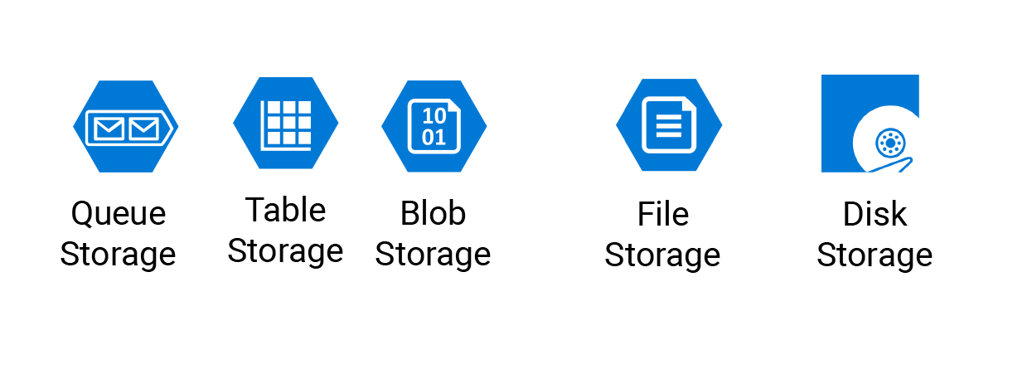







Azure Lambda Architecture with Change Feed
Azure platform products and services used
Data Source(s)
Batch Layer
Serving Layer
Encounter
EMS
HDInsight/Databricks
Blob/Table storage / Cosmos DB Container
Decision Layer
Lab
Cosmos DB
Change Feed
Databricks
Pharmacy
Speed Layer
Event Hubs
Scala
Membership
Real-time View
Billing
Layer | Description | Azure Services used
Batch layer | Manages master dataset, an immutable, append-only set of raw data Generates Change Feed events Pre-compute the batch views | Azure HDInsight or Azure Spark, and Azure Cosmos DB for the master dataset
Speed layer | Most recent data only and provides real-time views Compensates for the high latency of updates to the serving layer | Azure Spark on HDInsight or a serverless computing service, e.g., Azure Function App
Serving layer | Persists pre-computed batch and real-time views for fast responses | Azure Blob, Table storage or Cosmos DB container
Decision layer | Determines whether to use Batch view(s), or Real-time view(s), or merging of the two. Minimizes query logic complexity | Uses Python/Scala on HDInsight/Databricks platform. Also, a serverless computing service, e.g., Azure Function App

Slide 8

Potential Healthcare use cases
Electronic Health Records - keep track of each patient’s health chart and their medical reports, thereby reducing the need for duplicate tests and the associated cost.
Real-time Alerts - Help doctors analyze patient’s health conditions in real-time to make quick informed decisions. Clinical support decision can offer prescription(s) after analyzing a patient’s medical data.
Track devices and vehicles in real-time – track emergency transportation vehicles to make preparations to provide most expeditious care. Could be a difference between life and death.
Evidence Based Medicine - provide doctors with the evidence of a patient’s record and comparison of symptoms to a larger patient database; thereby enabling accurate, faster, and more efficient treatments. It helps easy decision making and better patient care.
Fraud Detection - Every data is unique and it is essential to maintain the integrity of data along with its security. It helps in the billing, personal identity, and patient records. Providers can use real-time data analytics to prevent fraudulent insurance claims.
Public Sentiment Analysis - Help companies to be social media savvy and react quickly to public sentiment.

Slide 9
Pros and Cons of Lambda Architecture
Pros
Cons
Batch layer manages historical data with the fault tolerant distributed storage which ensures low possibility of errors even if the system crashes.
Fault tolerant to human errors.
React in real-time to the changing business/market scenarios.
It is a good balance of speed and reliability.
Scalable architecture for data processing.
New algorithms, analytics, or new business use cases can be applied at any time - by simply recreating the batch and speed views.
Separation of concerns enables each individual concern to be scaled individually.
Considered complex because of its different layers. Changes in one layer necessitate changes on the other layer.
Two distinct and fully distributed layers (batch and speed), make maintenance and support activities duplicate and challenging.
It can result in coding overhead due to involvement of comprehensive processing.
Re-processes every batch cycle which is not beneficial in certain scenarios.
A data modeled with Lambda architecture is difficult to migrate or reorganize.
Multiple technologies would have to be mastered.
Implementing a Lambda Architecture with open sources technologies and then deploying in the cloud can be burdensome.

Slide 10

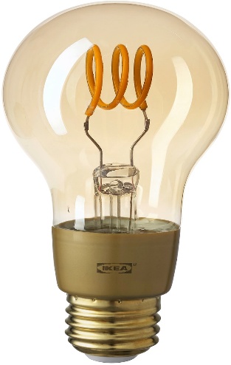
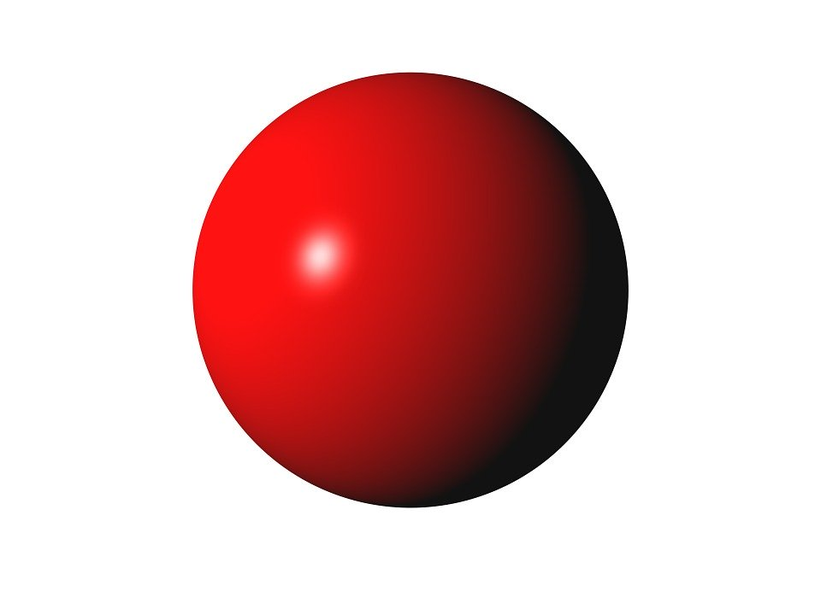
Key Takeaway
Lambda architecture is a pattern that can be implemented using many different technologies, languages and platforms
Best suited for ad-hoc queries where near real-time information is required
Focuses on balancing latency, throughput, and fault-tolerance
Azure Lambda Architecture with Change Feed simplifies the implementation and eliminates the multicast issues
One size does not fit all - processes and tools should be selected based on the use case
No definitive answer as to which architecture is suitable for an organization. Business case and outcomes determine the best suited architecture for the data processing
Failures to understand the challenge can range from complete failure to simply degradation of service.
Kappa Architecture focuses on processing data as a stream only and is suitable to provide real-time analytics. It is based on Apache Kafka, which is extremely fast, fault tolerant and horizontally scalable
Architectures, such as Delta Architecture, tackle the batch latency issues by writing batch and streaming data into the same table. It allows a simpler architecture and quicker data ingestion to query result

Slide 12
Appendix

Slide 13
Big Data Architectures at a glance – Kappa, Lambda & Delta Architectures
 | Kappa Architecture | Lambda Architecture | Delta Architecture
Overview | A real-time big data processing solution A simplification of Lambda Architecture, not a replacement It addresses the Lambda Architecture’s weakness: complexity of having to maintain two paths (Batch and Speed) Kappa architecture is based on Apache Kafka, which is extremely fast, fault tolerant and horizontally scalable It meets all requirements of the Lambda Architecture, e.g., low-latency, distributed, event topics and rapid access to events data | A near real-time big data processing solution Handles large quantities of data by leveraging both batch and stream-processing Mitigates latencies of batch processing Comprised of a master dataset and a set of layers – batch layer, speed layer and serving layer Ideal for use cases where: Data needs to be served in near real-time Requests are served on ad-hoc basis against all data | A batch big data processing solution with much shorter processing cycle than a traditional batch cycle A continuous data flow model to unify batch and streaming The preferred platform is Azure Databricks
Principles | Everything is a stream - Kappa Architecture is based on processing data as a stream only The incoming data stream is replayed quickly in its entirety or from a specific position Immutable data sources - Kappa architecture pattern is based on append-only, immutable log Single analytics framework - Only one analytics engine is required | Dependent on data principles of append-only, immutable, and atomicity Balance of latency, throughput, and fault-tolerance Correlate with growth of big data and real-time analytics Mitigate latencies of batch processing Handle massive quantities of data by leveraging both batch and stream-processing | A single repository for all data sources and types Easy searches by leveraging data catalogs and metadata management Implement adequate governance and multi-tenancy for appropriate access control A robust business operations platform with built-in high availability, backup, and constant recovery A consistent ingestion mechanism with schema and metadata enforcement
How it works | It persists event data in an ordered, immutable, log data structure that can be replayed at high-throughput to serve batch needs Data is run through the real-time streaming system (speed layer) in its entirety from the beginning Results are stored in the serving layer for queries Handles both real-time data processing and continuous reprocessing in a single stream processing engine When any code changes, a second stream is run to refresh the data stored in the serving layer Kafka retains the ordered data for indefinite period | Comprised of a master dataset and three layers – Batch, Speed and Serving All data is dispatched to both batch and speed layers for processing Batch layer manages the master dataset, an immutable, append-only set of raw data and pre-computes the batch views The speed layer compensates for the high latency The serving layer combines batch and real-time views Lambda architecture is query=function(over all data) | Data from disparate data sources is collected into a raw table ("bronze") at Databricks A Raw table is then parsed into query tables ("silver"). They may be joined with dimension tables Summary tables ("gold") are business level aggregates often used for reporting and dashboarding The results are actionable insights, dashboards and reports of business metrics

Slide 14
Big Data Architectures at a glance – Kappa, Lambda & Delta Architectures
 | Kappa Architecture | Lambda Architecture | Delta Architecture
Benefits/ Advantages | Using Kafka, the need for batch processing system is eliminated Simplified architecture Maintain only one codebase and one data source for queries Companies such as, LinkedIn use this for big data processing and retain large amount of data to respond quickly | React in real-time to the changing business / market scenarios Ad-hoc data discovery for true value-based models. Informed decisions, high level reliability and consumer confidence Fault tolerant to machines and human mistakes All layers can be scaled independently Secure environment, many tools and platforms to choose from, industry standards, and guaranteed SLA’s Cosmos DB - high availability, minimal latency, Change feed and SLAs | Delta Lake is an open source project with the Linux Foundation High data quality by adding a storage layer to data lakes and intermediate hops Incrementally improve data quality with schema on read and write ACID transactions on Spark platform A table in Delta Lake serves as a batch table, a streaming source and a sink Automatic schema enforcement during ingestion
Use cases | When there is no need to go back and playback all the data and insights can be derived from live streams ML and analytical models can be built data stream(s) Multiple data events or queries are logged in a queue to be catered against a distributed file system storage or history The order of the events and queries is not predetermined. It is resilient and highly available to handle Terabytes of storage required for each node to support replication Social network applications, devices monitoring system and IoT using the streaming layer(s) | Electronic Health Records - keep track of patient’s health chart and medical reports Real-time Alerts - Help doctors analyze patient’s health conditions in real-time and make informed decisions Track emergency transportation vehicles to provide most expeditious care Evidence Based Medicine – Compare symptoms to a larger database to provide accurate, faster, and efficient treatments Fraud Detection – Detect fraud in claims, billing, personal identity, and patient records in real-time Public Sentiment Analysis - react quickly to public sentiment | When Databricks components are in use and need a data pipeline solution to build out the data lake Already using Hadoop/Spark stack and need to simplify the data pipeline architecture and improve performance Process really large datasets that require high volume processing capabilities without the management of metadata, backups, upserts, and data consistency ACID transactions, schema enforcement, and audit history for the big data system When datasets cannot be implemented in a traditional database solution When data consistency is more important than the speed of getting the data to the data lake

Slide 15
Big Data Architectures at a glance – Kappa, Lambda & Delta Architectures – cont’d
 | Kappa Architecture | Lambda Architecture | Delta Architecture
Pros | Can be used for data systems that are online learners and don’t need the batch layer. When batch and streaming analysis are identical, then using Kappa is likely the best solution. Re-processing is required only when the code changes. Can be deployed with fixed memory. It can be used for horizontally scalable systems. Requires fewer resources since the machine learning is being done on real time basis. | Batch layer manages historical data Fault tolerant to machine and human errors. React in real-time to the changing business/market scenarios It is a good balance of speed and reliability. Scalable architecture for data processing. A good candidate for asynchronous processing Each layer can be independently debugged New algorithms, analytics, or new business use cases can be applied at any time - recreate the batch and speed views. Each layer/component can be scaled individually. | Reduce end-to-end pipeline SLA from days and hours to minutes Reduce pipeline maintenance burden – great candidate for minute-latency use cases Simplify Change data capture, GDPR, sessionization, deduplication use cases Lower infrastructure costs with elastic compute storage - reduce infrastructure costs by up to 10x
Cons | Does not handle duplicate events, cross-referencing events or maintaining order very well Metadata solutions cannot be used for governance since data is processed at stream Use cases for Kappa are somewhat limited Not well suited for very complex situations where the batch and streaming algorithms produce very different results | Considered complex because of its different layers. Changes in one layer will necessitate changes on the other layer. Two distinct and fully distributed layers (batch and speed), make coding, maintenance and support activities challenging. Re-processes every batch cycle is not beneficial in certain scenarios. A data modeled with Lambda architecture is difficult to migrate or reorganize. Requires expertise in multiple technologies. | Only available as part of Databricks ecosystem. Databricks is not currently available on GCP. Tools and skills compatibility could be an issue. Data from the Delta tables need to be consistently migrated to another system upstream. Most of the use of Delta Lake is within the Databricks ecosystem.

Slide 16
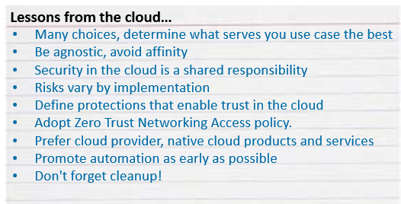


Cloud Adoption Best Practices
Leverage Advisors and cost calculators (available in all platforms)
Remediate Azure Advisor recommendations
Integrate Advisor with the ticketing system
Billing should be properly managed, e.g., properly design tag schema and use it effectively
Resources should be created at beginning and discarded after each use, otherwise they keep accruing expenses
Security is a big challenge and should be diligently practiced. New security models, such as adaptive security models should be considered
Managed Service Identity (MSI) should be used for all non-public facing services
Every solution architecture must address: scalability, availability, resiliency, management, and security
Make all things redundant
Minimize coordination and dependency
Design to scale out
Partition around limits
Design operations
Choose the right data analytics tool for the right job
Analyze continuously
Maximize automation
Consume services programmatically via API
Leverage PaaS and serverless services , e.g., Function Apps, Logic Apps, etc.
Monitoring and measuring are critical
Start slow, react fast in leveraging Big Data
Choose the right storage type for the right job - Hot, Cold, archive
Configure appropriate access tier, e.g., Hot, Cool, Archive
Storage type - File, Blob, Queue, Table
Disk Types: managed and unmanaged; Premium and Standard
Backdoor changes should be avoided to prevent inconsistency

Slide 17
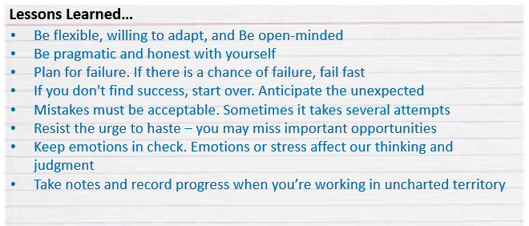
General Software Architecture Best Practices
Build for the need of business
Purpose built – Ensure specific use cases
Clearly define business objectives
Identify key stakeholders and decision makers
Engage business community throughout the SDLC
Identify source of information
Identify timelines, constraints
Identify risks and assumptions early
document response SLAs - real-time, near real-time, batch (hourly, daily, etc.)
Design solutions modular to scale each component/capability independently
Define conceptual and logical architectures
Design for tomorrow, but build for today
A solution must address, at minimum, Security, scalability, Resiliency, automation concerns. For example, adaptive security, configuration-based scalability, recovery from failures and continue to function, and DevOps automation
Don’t let the tools drive the architecture and solution
Minimize tools mixture – more tools, more integration challenges
When platforms and tools are new, conduct a POC
No big bang approach. Start small, learn from experience, retrofit the process
Start with the small group of the willing and expand it to wider audience by seeding early adopters into other teams
When adoption timeline is short, engage a vendor partner, to setup the platform, tools, training, best practices, controls and training for a head start
Provide personnel adequate training and support
Build knowledge repository and make it easily searchable
Avoid single point of failure
No implicit dependency - develop self-contained components
Minimize data movement - Leverage provider data duplication/availability services
Plan breaking changes carefully – assume that everybody will not start using the change on the first day.

Slide 18

Cloud Risks - Vulnerabilities, risks and guidelines
Speculative execution side-channel vulnerabilities
Meltdown pertains to exploiting vulnerabilities with the underlying processor (CPU) running the code to access information. Both Spectre and Meltdown permit side-channel attacks because they break down the isolation between applications, VMs, etc.
In the case of Meltdown, the only way to address this is to aggressively “detune” code (including application code) and force the processor to behave correctly.
Cloud providers (public, private, and hybrid) are all potentially affected by these vulnerabilities, so they must guard against them by ensuring that all the latest patches are in place. Patched are not yet available for all of these vulnerabilities.
Risks
An attacker that is able to access a system through unprivileged log in can read information from the kernel, or can read the host kernel if she is a root user on a guest virtual machine (VM). In a cloud environment, this can be used across customers and cannot be detected.
This is a huge issue for cloud service providers. The patches might degrade performance, so some businesses might choose to leave their systems unpatched.
Guidelines
The CERT Advisory is recommending the replacement of all affected processors. Request information on how cloud providers (vendor and internal) are responding to Meltdown and Spectre, and other side-channel vulnerabilities.
Azure is using memory preserving maintenance whenever possible and Azure Confidential Computing, to minimize customer impact and eliminate the need for reboots.
Do not mix workloads from different security zones on the same host.
Evaluate workloads vs. these risks when determining what cloud services to use.

Slide 19
Kappa Architecture

Slide 20
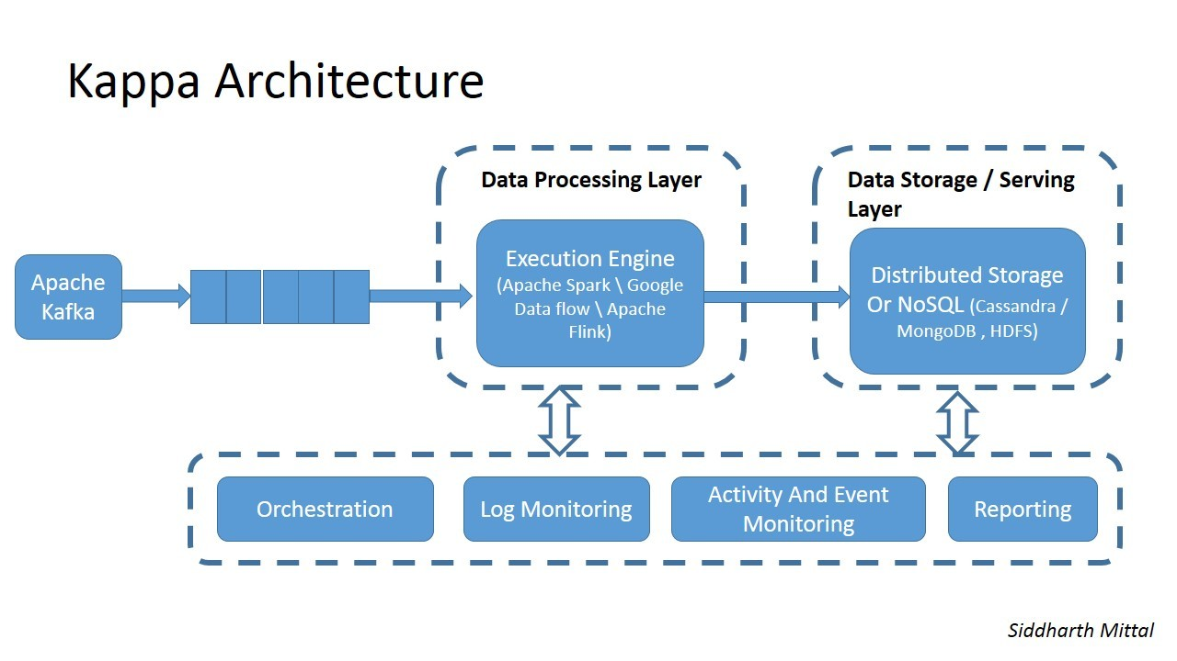
Kappa Architecture
Kappa Architecture is a simplification of Lambda Architecture, not a replacement. It addresses the Lambda Architecture’s weakness: complexity of having to maintain two paths (Batch and Speed).
Kappa architecture pattern is based on append-only, immutable log. The data, from the log, is streamed through a computational system for serving layer.
Kafka is the main component of this architecture. It meets all requirements of the Lambda Architecture, e.g., low-latency, distributed, event topics and rapid access to events data.
It persists event data in an ordered, immutable, log data structure that can be replayed at high-throughput to serve batch needs.
Kappa Architecture focuses on processing data as a stream only. It requires the incoming data stream be replayed quickly in its entirety or from a specific position.
Using Kafka, the need for batch processing system is eliminated; data is run through the streaming system from the beginning.
The incoming data is streamed through a real-time (speed) layer and the results are stored in the serving layer for queries.
Handles both real-time data processing and continuous reprocessing in a single stream processing engine. Maintains one codebase and only one data source for queries
When any code changes, a second stream process replays all previous data through the latest real-time engine and replace data stored in the serving layer.
Data processing/Speed
Layer
Query = K (New Data) = K (Live streaming data)

Slide 21
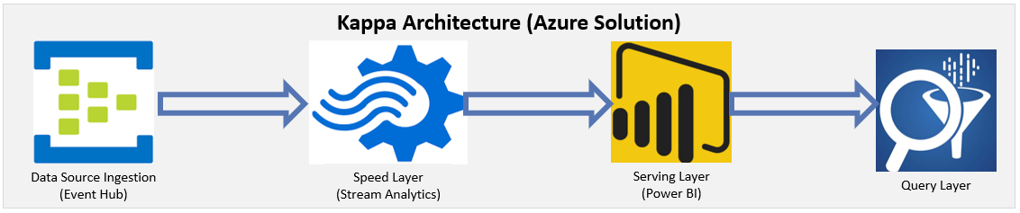
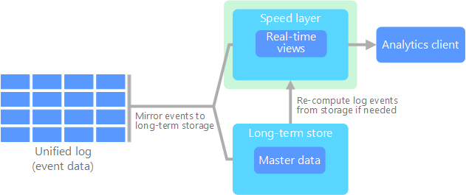
Kappa Architecture – cont’d
Kappa architecture is based on Apache Kafka, which is extremely fast, fault tolerant and horizontally scalable. It provides a better mechanism for governing data-streams. Kafka retains the ordered data for indefinite period. Companies such as, LinkedIn use this for big data processing and retain large amount of data to respond quickly to similar/repetitive queries.
All data flows through a single path, using a stream processing system.
The event data is immutable and all of it is collected, instead of a subset.
The data is ingested as a stream of ordered events into a distributed and fault tolerant unified log.
All event processing is performed on the input stream and persisted as a real-time view.
If recompute of the entire data set is required, you replay the stream, typically using parallelism to complete the computation in a timely fashion.
You can stream data for different time windows based on the use case.
The data playback can be handled using the code at the subscriber level.
Speed layer
The speed layer processes data streams in and keeps the queue active for indefinite time.
The speed layer is double purposed as batch layer and can be configured to playback historical data.
Serving layer
Output from the speed layer can be consumed by various subscribers using serving layer
It responds to ad-hoc queries by returning pre-computed views or building views

Slide 22
Kappa Architecture – use cases
Kappa architecture use cases:
When there is no need to go back and playback all the data and insights can be derived from live streams.
Machine learning and analytical models can be built using the stream
Multiple data events or queries are logged in a queue to be catered against a distributed file system storage or history.
The order of the events and queries is not predetermined. Stream processing platforms can interact with database at any time.
It is resilient and highly available as handling Terabytes of storage is required for each node of the system to support replication.
Social network applications, and devices connected to a cloud-based monitoring system and IoT use the streaming layer to process the data over the data lake.

Slide 23
Pros and Cons of Kappa Architecture
Pros
Cons
Can be used for data systems that are online learners and don’t need the batch layer.
When batch and streaming analysis are identical, then using Kappa is likely the best solution.
Re-processing is required only when the code changes.
It can be deployed with fixed memory.
It can be used for horizontally scalable systems.
Need fewer resources since the machine learning is being done on real time basis.
Does not handle duplicate events, cross-referencing events or maintaining order very well
Metadata solutions cannot be used for governance since the data is processed at stream only.
Use cases for Kappa are somewhat limited
Not well suited for very complex situations where the batch and streaming algorithms produce very different results

Slide 24
Lambda Architecture

Slide 25
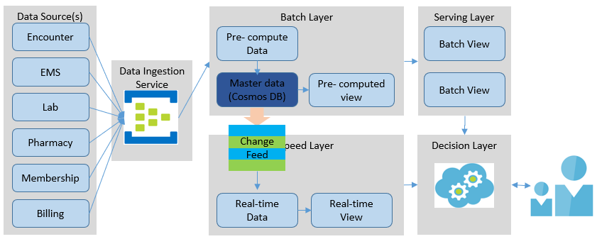
Azure Lambda Architecture with Change Feed – Detailed I
Data Sources: There can be various source systems which send data at different times, different time intervals and at different velocity. Some can send data continuously (streaming data) while others can send only send once a day (batch).
Data Ingestion Service: Even though the data ingestion service is optional. Still, it is highly recommended to build the simplicity, resiliency, reliability, and availability of the service. For the data ingestion service, the Azure Event Hubs is recommended for the following reasons: it has multiple (up to 10) endpoints without accruing any additional cost and it is built for high volume, high frequency events. Event Hubs Dedicated can ingest up to 2 million events/second. The SLA are guaranteed.
Batch Layer: It manages the master dataset and pre-computes batch views, as well as re-compute batch views, when required. The focus of this layer to perfect the accuracy and completeness by processing all available data by producing accurate results at a point-in-time at scale. This layer hosts the master dataset, an immutable, append-only set of raw data. It is composed of a distributed file system such as HDFS/ADLS Gen2 and a computation engine such as Azure HDInsight or Azure Databricks. Azure Cosmos DB serves as the master dataset repository. The Cosmos DB automatically generates Change feed events. As soon as the events data is received, it is appended to the master dataset. The Azure Cosmos DB is selected to achieve a simpler architecture; the data ingestion service needs to post data to only one endpoint; thus, avoiding multicast issues. It is built for any size, high velocity and high-volume data operations. The Change feed event generation is enabled by default, which is guaranteed. In addition, each change to an item appears exactly once in the change feed and the change feed is sorted by the order of modification.

Slide 26
Azure Lambda Architecture with Change Feed – Detailed II
Speed Layer: The purpose of the speed layer is to compensate for the high latency of refreshing the serving layer and provides real-time views into the most recent data. It processes data streams in real-time, without fix-ups or completeness to minimize the latency. It fills the "gap" caused by the batch layer. It may not be as accurate or complete as the batch layer. However, these discrepancies are rectified by the batch layer the next time processing occurs. The speed layer subscribes to the Change Feed events generated by the Cosmos DB to create Real-time views. It provides the outputs on the basis of enrichment process and supports the serving layer to reduce the latency. Most of the complexity is pushed onto this, much smaller, layer where the results are only temporary, a process called “complexity isolation”. It can utilize Azure HDInsight (Apache Spark), Azure Databricks or serverless computing (Azure Functions) as the platform to read the Azure Cosmos DB Change feed to create Real-time views. The real-time views can be stored in Databricks, HDInsight storage, or in Cosmos DB. It provides incremental updates instead of re-computation updates. It operates only on the delta changes since the last batch run. It requires cleanup of the real-time view(s) that have been incorporated into the batch views. This process requires custom components to handle complex logic and clean-up processes.
Serving Layer: Quickly responds to consumer requests. The serving layer combines batch views and real-time views to give results in real-time for any ad-hoc query over all data. The output from the batch and speed layers are stored in the serving layer, which responds to ad-hoc queries by returning precomputed views or building views from the processed data. The serving layer views can be stored in any NoSQL, Document DB. Since Azure Cosmos DB is used in the previous layers, it is recommended to be used in this layer as well. The reason being, leverage experience gained thus far; it performs as well as any database in its class and it is a fully managed service. Once the computed views from batch and speed layers are stored in the Document DB, the Decision layer will determine how best to serve the queries. The stored views are indexed to achieve low-latency for the user requests
Decision Layer: The Decision layer determines how best to respond to user queries. Based on the query, it determines whether to respond with Batch view(s) or Real-time view(s) or the combination thereof. The motivation for this layer is to abstract the query logic complexity from the serving layer. And the requestor does not have to know layer of views to call. It can run on HDInsight or Databricks platform and any language such as, Python, Scala or any other language of your choice. A serverless computing service, such as, Azure Function App can also be used for this purpose. It will relieve you of the responsibility of having to maintain an additional service.

Slide 27
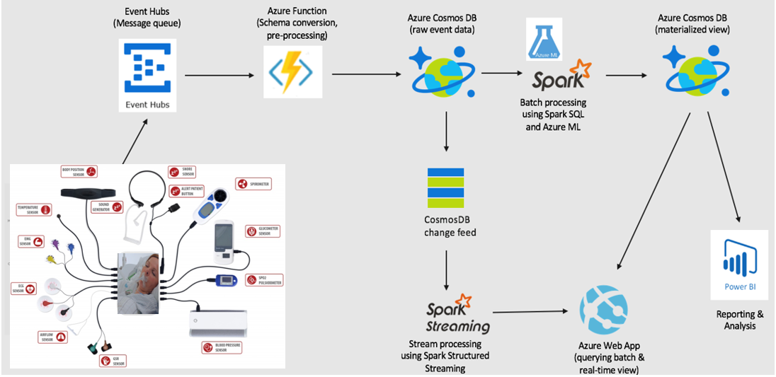
Streaming at scale using Azure Lambda Architecture with Change Feed

Slide 28
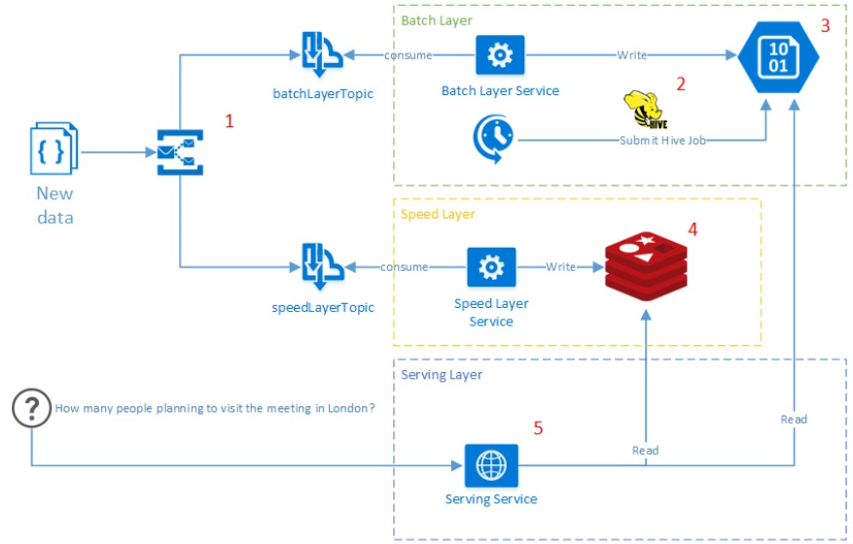
Lambda Architecture on Azure Platform
Infrastructure
Azure Service Bus - message broker which guarantees reliable message delivery to both batch and speed layer.
Service Fabrik - responsible for publishing services on Azure instances and scaling
ARM templates - infrastructure for deployment the Meetup Analytics system to the Azure cloud
Layers
Batch Layer
HDInsight Blob Storage - distributed file system (Hadoop), represents master dataset of the Meetup Analytics
Hive - allows run Hadoop job and perform intensive aggregations against a data in HDInsight Blob Storage using SQL-like syntax
Speed Layer
Redis - in-memory, key-value, NoSQL data storage with fast read and write operations
Serving Layer
Represented by simple REST service which publicly available for user's requests

Slide 29
Delta Architecture

Slide 30
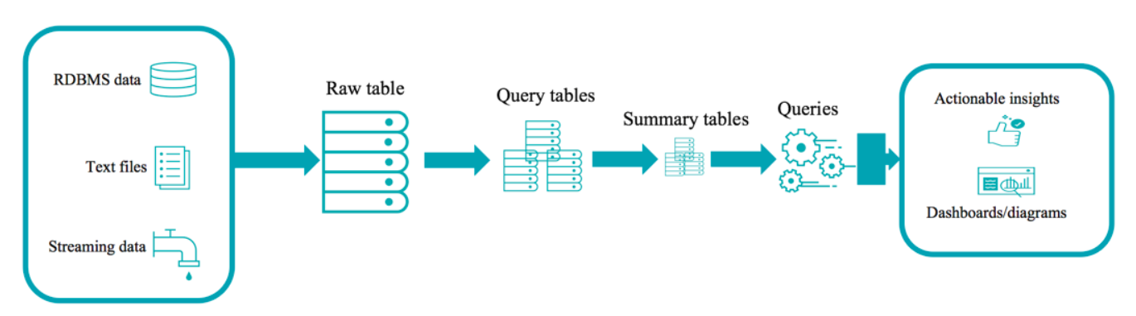

Delta Architecture
A continuous data flow model to unify batch and streaming
Raw table
(Bronze)
Query tables
(Silver)
Summary tables
(Gold)
Data from disparate data sources is collected into a raw table (also known as "bronze" tables at Databricks).
A Raw table is then parsed into query tables (also known as "silver" tables at Databricks). They may be joined with dimension tables.
Summary tables (also known as "gold" tables at Databricks) are business level aggregates often used for reporting and dashboarding. This would include aggregations such as daily active website users.
The end outputs are actionable insights, dashboards and reports of business metrics.

Slide 31
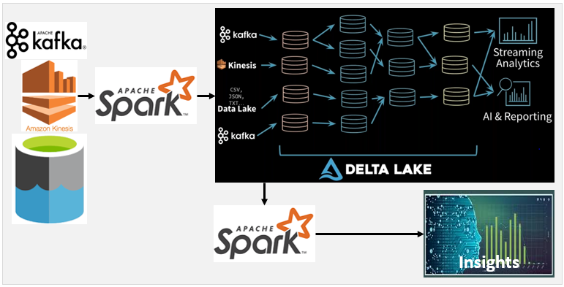
Delta Architecture
Delta Architecture Capabilities
Ability to read consistent data while data is being written - Snapshot isolation between writers and readers
Ability to read incrementally from a large table with good throughput - Optimized file source with scalable metadata handling
Ability to rollback in case of bad writes - Time travel
Ability to replay historical data along newly arrived data - Stream the historical data through the same pipeline as new data
Handles late arriving data without delaying downstream processing - Stream late arriving data added to the table as it arrives
Incrementally load the new data efficiently. No need to do state management on what are the new files added.

Slide 32
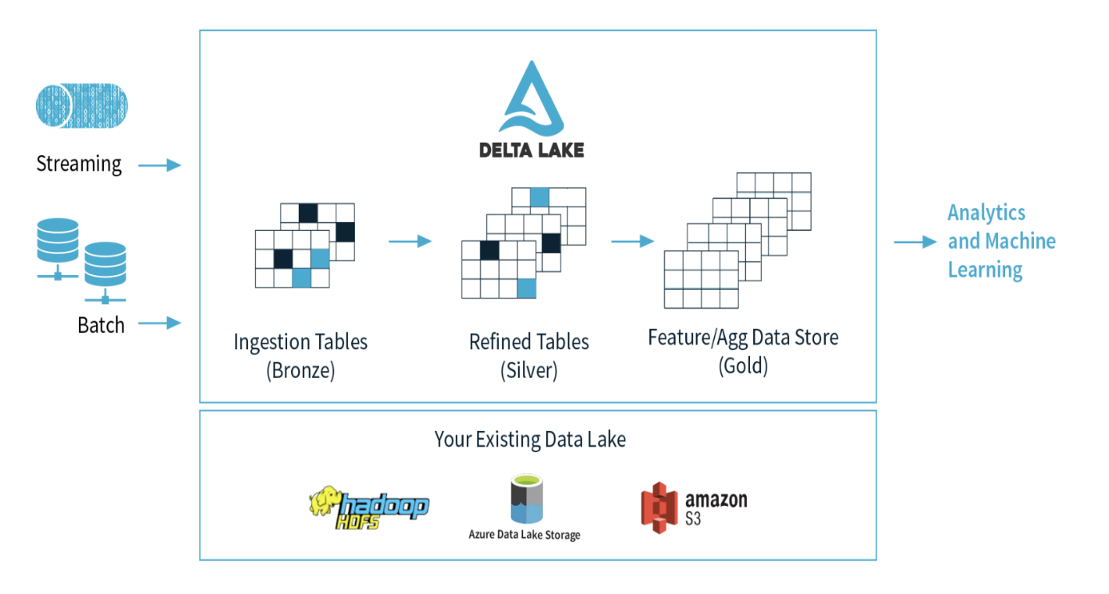
Delta Architecture Benefits
Open & Extensible: Delta Lake is an open source project with the Linux Foundation. APIs are open and compatible with Apache Spark™.
Data Reliability: Delta Lake adds a storage layer to data lakes and intermediate hops to manage data quality, ensuring data lakes contain only high quality data.
Incremental quality improvement: Incrementally improve the quality of data until it is ready for consumption with schema on read and write
Manage Data Lifecycle: Handle changing records and evolving schemas as business requirements change.
Optimization: Optimization of the storage layout based on access patterns
ACID transactions on Spark: Serializable isolation levels ensure that readers never see inconsistent data.
Scalable metadata handling: Leverages Spark’s distributed processing power to handle all the metadata for petabyte-scale tables with billions of files.
Streaming and batch unification: A table in Delta Lake is a batch table as well as a streaming source and sink. Streaming data ingest, batch historic backfill, interactive queries all just work out of the box.
Schema enforcement: Automatically handles schema variations to prevent insertion of bad records during ingestion.
Time travel: Data versioning enables rollbacks, full historical audit trails, and reproducible machine learning experiments.
Reprocess historical data: Simply clear out the result tables and restart the stream
Upserts and deletes: Supports merge, update and delete operations to enable complex use cases like change-data-capture, slowly-changing-dimension (SCD) operations, and streaming upserts.
Existing Data Lake

Slide 33
Delta Architecture use cases
When you’re already using Databricks components and needs a data pipeline solution to build out the data lake.
You are currently using the Hadoop/Spark stack and would like to simplify the data pipeline architecture while improving performance.
When dealing with really large datasets that require high volume processing capabilities but without the hassle of managing the metadata, backups, upserts, and data consistency.
When you need ACID transactions, schema enforcement, and audit history for the big data system
When datasets cannot be implemented in a traditional database solution.
When data consistency is more important than the speed of getting the data to the data lake.
When your cloud provider is not GCP

Slide 34
Delta Architecture
Pros
Cons
Reduce end-to-end pipeline SLA
Organizations have reduced pipeline SLAs from days and hours to minutes
Reduce pipeline maintenance burden
Eliminate need for lambda architecture for minute-latency use cases
Handle updates and delete easily
Change data capture, GDPR, sessionization, deduplication use cases simplified
Lower infrastructure costs with elastic, independent compute storage
Organizations reduce infrastructure costs by up to 10x
Delta is only available as part of the Databricks ecosystem. Consider tools and skills compatibility issues prior to moving forward with Delta.
Databricks is not currently available on GCP.
There are some challenges if the data from the Delta tables need to be consistently migrated to another system upstream.
Does not support true data lineage (the ability to track when and how data has been copied within the Delta Lake).
Can’t access Delta Lake tables outside of Databricks Runtime as ingestion requires using the Delta ACID API.
Most of the use of Delta Lake is within the Databricks ecosystem.
Consider the cost of a Databricks solution.

Slide 35

Work in Progress

Slide 36
Lambda Architecture
Lambda architecture handles massive quantities of data by leveraging both batch and stream-processing
Mitigates latencies of map-reduce
Comprised of a data model (master dataset) with an append-only, immutable data source
Has three layers: batch layer (accuracy and completeness), speed (or real-time) layer, and a serving layer for responding to queries
Batch layer - has two basic functions: manage the master dataset and pre-compute batch views. It aims to perfect the accuracy by processing all available data
Speed layer - processes data streams in real-time, without fix-ups or completeness to minimize the latency. It fills the "gap" caused by the batch layer. May not be as accurate or complete as the batch layer and can be replaced when the batch layer's views for the same data become available
Serving layer - Output from the batch and speed layers are stored in the serving layer, which responds to consumer requests
Criticism - Inherent complexity and its limiting influence. The batch and streaming sides each require a different code base that must be maintained and kept in sync
Alternative - A flexible streaming framework such as Apache Samza could provide some of the same benefits without the latency; a streaming framework could allow for collecting and processing arbitrarily large windows of data, accommodate blocking, and handle state.
Advantages of Lambda Architecture
Robustness and fault tolerance - the system is tolerant to machines failure and human mistakes such as data corruption. The batch and real-time views can be always recomputed from the master dataset.
Low latency read and update - the Lambda Architecture allows to achieve both without compromising robustness.
Scalability - all layers can be scaled independently.
Generalization - Lambda Architecture can be used across a large number of different applications. - Wikipedia

Slide 37
Patterns of Lambda Architecture
This architecture has three layers – batch layer, speed layer and serving layer
All data entering the system is dispatched to both the batch layer and the speed layer for processing
The batch layer has two functions:
Manage the master dataset, an immutable, append-only set of raw data
Pre-compute the batch views
The speed layer compensates for the high latency of updates to the serving layer and deals with recent data only, providing real-time views
The serving layer combines batch view and real-time views to give results in real-time for any ad-hoc query over all data
Bottom line: lambda architecture is query=function(over all data)
Near real-time data processing architecture. Companies like Twitter, Netflix, and Yahoo are using it to meet the quality of service standards.

Slide 38
Azure Lambda Architecture
The Azure Lambda Architecture is identical to the reference Lambda architecture
Data Source(s)
Batch Layer
Serving Layer
Encounter
Pre- compute Data
Batch View
Data Ingestion Service
Lab
Master data
Batch View
Decision Layer
Pharmacy
Speed Layer
Membership
Real-time Data
Real-time View
Billing
Advantages of Azure Lambda Architecture
Lower complexity – no need to deliver data to multiple endpoints
Security – no compromise on the data security ; provides security for both data in rest and flight
Flexibility – You have flexibility to use open source capabilities such as spark , hive , Sqoop etc. on Azure and continue leveraging your hard earned skill
Supportability – supports heterogeneous platforms based devices and various protocols & industry standards
Adaptability – when a particular protocol is not supported , you have freedom to have protocol adapter to standardize to a particular protocol
Optimized cost – pay as you go
Reliability – Azure SLAs are defined at services levels and transparent
Supports all communication patterns – Telemetry , Inquiries , Commands & Notifications

Slide 39
Azure Lambda Architecture with Change Feed
Data Source(s)
Batch Layer
Serving Layer
The Azure Lambda Architecture with Change Feed is an evolution of the original Lambda Architecture. It has evolved in the following ways:
The data ingestion service uses Azure Event Hubs, has multiple (up to 10) endpoints and built for high volume, high frequency scenarios. Event Hubs Dedicated can ingest up to 2 million events/second.
All data is pushed only into Azure Cosmos DB. Eliminates multi-casting issues.
Cosmos DB serves as the master data (immutable, append-only) repository. Cosmos DB is selected based on the following factors:
Well-suited for high velocity and high volume data operations
Change feed is enabled by default for all Azure Cosmos accounts
Each change to an item appears exactly once in the change feed
The change feed is sorted by the order of modification
As soon as the data is merged into the master data (Cosmos DB), Change feed events generated.
The speed layer utilizes HDInsight (Apache Spark) to read the Azure Cosmos DB change feed to create Real-time views.
The Decision Layer analyzes the query and determines whether to utilize Batch view(s), or Real-time view(s), or merging of the two. It relieves the consumer of the query logic complexity
This architecture utilizes mature Azure services and platform with very little custom development – significantly shorter time to value!
Encounter
Pre- compute Views
Batch View
Lab
Data Ingestion Service
Master data
(Cosmos DB)
Batch View
Pharmacy
Change Feed
Speed Layer
Decision Layer
Membership
Billing
Real-time Data
Real-time View
Cosmos DB
Service guarantees - high availability, minimal latency, and comprehensive SLAs
Adapts to all sizes of databases through elastic throughput
Provides automatic data maneuvering through Change Feed
Integrates natively with data processing engines -> Apache Spark
Integrates natively with serverless components.
Change Feed
Automatically enabled in any Cosmos DB database account.
Doesn’t need any additional configuration to start working.
Uses the existing allocated request units for processing events.
Executed on insert and update operations. Delete support can be implemented with a flag.
Can be used as a streaming layer without requiring another component.

Slide 40
Potential Healthcare use cases
Electronic Health Records - keep track of each patient’s health chart and their medical reports, thereby reducing the need for duplicate tests and the associated cost.
Real-time Alerts - Help doctors analyze patient’s health conditions in real-time to and make quick course correction, when required. Clinical support decision can offer prescription(s) after analyzing a patient’s medical data.
Getting ahead of Patient Deterioration - Can help providers react quickly to changes in a patient’s vitals, and may be able to identify an upcoming deterioration before symptoms clearly manifest themselves.
Prevent suicide and patient self-harm- Early identification of individuals likely to cause harm to themselves can ensure that these patients receive the mental healthcare they need to avoid serious events, including suicide.
Track in Real-time devices and vehicles – track emergency transportation vehicles to make preparations to provide most expeditious care. Could be a difference between life and death.
Evidence Based Medicine - provide doctors with the evidence of a patient’s record and compares the symptoms to a larger database of the patient; thereby enabling accurate, faster, and more efficient treatments. It helps easy decision making and better patient care.
Hospital Re-admissions - helps identify at-risk patients based on their medical reports, records, and laboratory reports and offer reduced readmission charges. This enables a patient to focus on the medical care and not so much on the readmission charges.
Fraud Detection - Every data is unique and it is essential to maintain the integrity of data along with its security. It helps in the billing, personal identity, and patient records. The insurance company can use real-time data analytics to prevent fraudulent insurance claims. Predictive analysis plays a vital role in fraud detection.
Public Sentiment Analysis - It helps companies to be social media savvy and react quickly to devise new policies, procedures and approaches.
Situation aware Planning, Care and Cost – Events, such as, natural disasters, adverse weather conditions, could require different resource planning, care type(s) and costs, e.g., no/lower charges to build goodwill and public support.
Forestalling appointment no-shows – unexpected gaps in appointments can have financial impact and work schedule plans. Real-time analytics can predict patients likely to miss the appoint. Improves provider satisfaction, cut down on revenue losses, and offer open slots to other patients, and increase speedy access to care.
Effective Management of Supply Chain - Significant opportunities for healthcare organizations to trim unnecessary spending and improve efficiency. Real-time analytics can reduce variation and gain more actionable insights into ordering patterns and supply utilization.
Business Benefits
React in real-time to the changing business / market scenarios
Predict from human behaviors to machines / devices lifetime patterns and make proactive informed decisions
informed decisions , ensure high level of services uptime and hence the good will.
Ad-hoc or exploratory data discovery for true value based payment models
Critical decision making in real-time such as, encounters, EMR, labs, benefits, billings, memberships

Slide 41


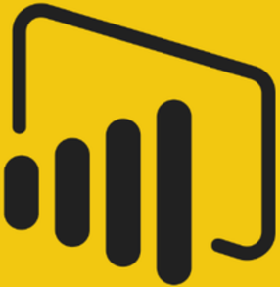

Data Source(s)
Batch Layer
Serving Layer
Encounter
Pre- compute Data
Batch View
EMS
Data Ingestion Service
Master data
(Cosmos DB)
Pre- computed view
Batch View
Lab
Pharmacy
Change Feed
Speed Layer
Decision Layer
Membership
Billing
Real-time Data
Real-time View
Kappa Architecture (Azure Solution)
Data Source Ingestion
(Event Hub)
Speed Layer
(Stream Analytics)
Serving Layer
(Power BI)
Query Layer

Slide 42
Kappa Architecture – Detail I
Kappa Architecture is a simplification of Lambda Architecture, not a replacement. It aims to tackle the Lambda Architecture’s weakness: complexity of having to maintain two paths (Batch and Speed), with separate implementations, technologies and codebases. And the serving layer having to reconcile the overlapping or different results.
Kappa architecture pattern is based on append-only, immutable log. The data, from the log, is streamed through a computational system for serving layer.
Kafka is the main component of this architecture. It meets all requirements of the Lambda Architecture, e.g., low-latency, distributed, event topics and rapid access to events as they occur.
The events data is persisted in an ordered, immutable, log data structure that can be replayed at high-throughput.
It processes data as a stream only and requires the incoming data stream be replayed (very quickly) in its entirety or from a specific position.
Kafka helps eliminate the batch processing system; data is run through the streaming system from the beginning.
The incoming data is streamed through a real-time (speed) layer and the results are stored in the serving layer for queries.
Real-time data processing and continuous reprocessing occur in a single stream processing engine.
Requires only one codebase and one data source for queries
When any code changes, then a second stream process would replay all previous data through the latest real-time engine and replace the data stored in the serving layer.
The only challenge is having to process this data in a stream, such as handling duplicate events, cross-referencing events or maintaining order- operations that are generally easier to do in batch processing.
Query = K (New Data) = K (Live streaming data)
Pros and Cons of Kappa architecture
Pros
Can be used for data systems that are online learners and don’t need the batch layer.
Re-processing is required only when the code changes.
It can be deployed with fixed memory.
It can be used for horizontally scalable systems.
Need fewer resources since the machine learning is being done on real time basis.
Cons
Absence of batch layer might result in errors during data processing or database updates that require an exception manager to reprocess the data or reconciliation.

Slide 43
Kappa Architecture – Detail II
Kappa architecture is based on Apache Kafka, which is extremely fast, fault tolerant and horizontally scalable. It allows a better mechanism for governing the data-streams. Kafka retains the ordered data for indefinite durations and caters the analogous queries by linking them to the appropriate position of the retained log. LinkedIn uses this for big data processing and retain large amount of data to respond to similar/repetitive queries quickly.
All data flows through a single path, using a stream processing system.
The event data is immutable and all of it is collected, instead of a subset.
The data is ingested as a stream of ordered events into a distributed and fault tolerant unified log.
All event processing is performed on the input stream and persisted as a real-time view.
If you need to recompute the entire data set, you simply replay the stream, typically using parallelism to complete the computation in a timely fashion.
You can stream data for different time windows based on the use case.
The data playback can be handled using the code at the subscriber level.
Kafka queue provides TTL that can be configured to indefinite to keep all the data in the stream.
Speed layer
The speed layer processes data streams in and keeps the queue active for indefinite time.
The speed layer is double purposed as batch layer and can be configured to playback historical data. This reduces the overheads of managing and transforming the data twice
Serving layer
Output from the speed layer can be consumed by various subscribers using serving layer
It responds to ad-hoc queries by returning pre-computed views or building views
Kappa architecture Use cases:
When there is no need to go back and playback all the data and insights can be extracted from live streams.
Machine learning and analytical models can be built using the stream and historical data not required
Multiple data events or queries are logged in a queue to be catered against a distributed file system storage or history.
The order of the events and queries is not predetermined. Stream processing platforms can interact with database at any time.
It is resilient and highly available as handling Terabytes of storage is required for each node of the system to support replication.
Social network applications, and devices connected to a cloud-based monitoring system and IoT use the speed layer with streaming layer to process the data over the data lake.

Slide 44
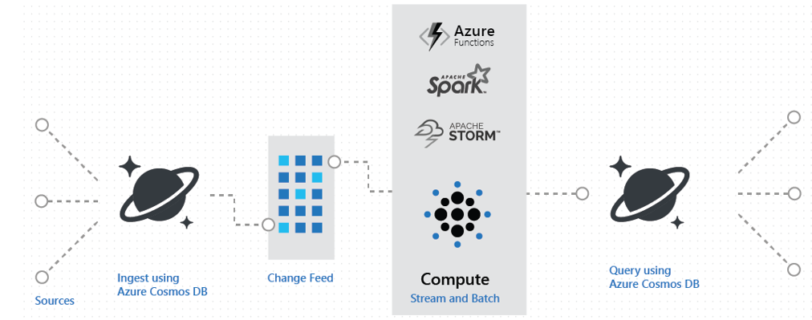
Lambda Architecture using Azure Cosmos DB via change feed
Scenarios
You can track encounters such as all the changes to a patient's profile, preferences, or their location and trigger certain actions, e.g., sending alerts, review latest information, alter treatments, etc.
Use change feed to implement real-time updates.

Slide 45
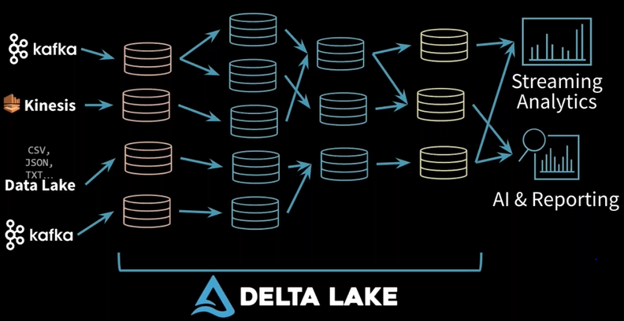

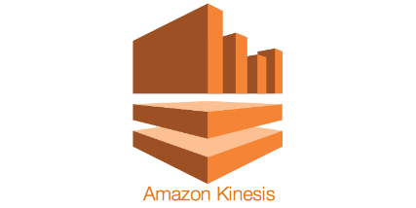

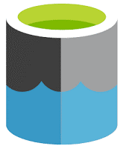
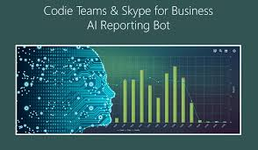
Azure Delta Lake Architecture
Insights
Delta Lake offers:
ACID transactions on Spark: Serializable isolation levels ensure that readers never see inconsistent data.
Scalable metadata handling: Leverages Spark’s distributed processing power to handle all the metadata for petabyte-scale tables with billions of files at ease.
Streaming and batch unification: A table in Delta Lake is a batch table as well as a streaming source and sink. Streaming data ingest, batch historic backfill, interactive queries all just work out of the box.
Schema enforcement: Automatically handles schema variations to prevent insertion of bad records during ingestion.
Time travel: Data versioning enables rollbacks, full historical audit trails, and reproducible machine learning experiments.
Upserts and deletes: Supports merge, update and delete operations to enable complex usecases like change-data-capture, slowly-changing-dimension (SCD) operations, streaming upserts, and so on.
Delta Lake on Databricks allows you to configure Delta Lake based on your workload patterns and provides optimized layouts and indexes for fast interactive queries. For information on Delta Lake on Databricks, see Optimizations.

Slide 46
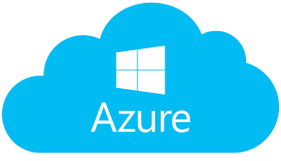
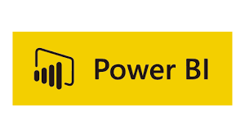
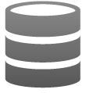

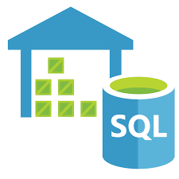
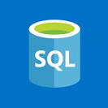










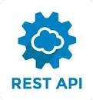



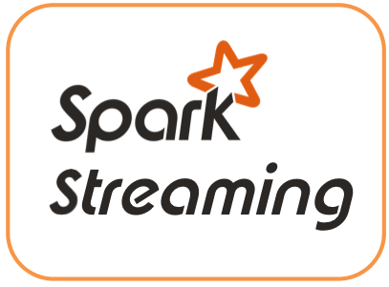





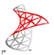





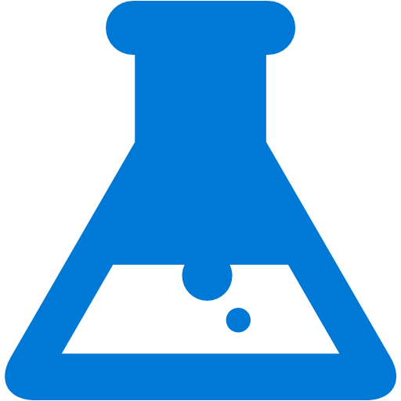
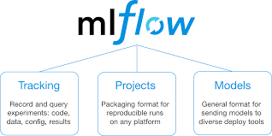
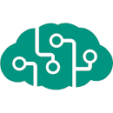

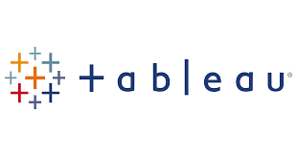




Azure Data Lake - Reference Architecture
Source layer
Aggregate layer
Analyze layer
Publish layer
Data Consumption
Source Layer
VPN
Data Access
Firewall
Curated Layer
Publish Layer
VPN
Azure Data Factory V2
Raw
Cleansed/
Enriched
AMI/CIS
ODBC/JDBC
Azure Databricks
Azure Databricks
PC
(VPN)
Azure SQL Data Warehouse & SQL DB
Azure Analysis Service
NMS
ADLS
Web Service
Files
ADLS
API
WMS
Event hub- Capture
Smart
Phone
Web Services
GIS
Express Route
Cosmos DB
Oracle Golden
Gate
Azure
DataBricks
Azure Functions
Azure API
APP
Downstream Data Systems
Semi-structured
Azure Event Hub
Un-structured
BizTalk
Azure Streaming Analytics
Insights/Models
Azure API
Management
Real Time Data
Azure API Management
& Logic APP
Azure ML
Databricks
ML Flow
Azure Cognitive Services
IOT
Audit balance and control
Batch
Authentication, Authorization, Accounting &
Data Protection
Secure Key Management
Orchestration
Monitoring and Administration
Azure DevOps
Near realtime
Azure Active Directory
Data Factory
Real-time
Key Vault
Azure Monitor

Slide 47
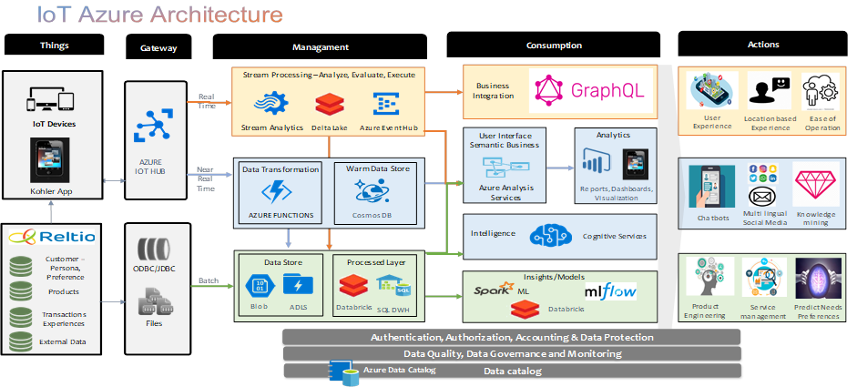
IoT Architecture

Slide 48






Slide 49
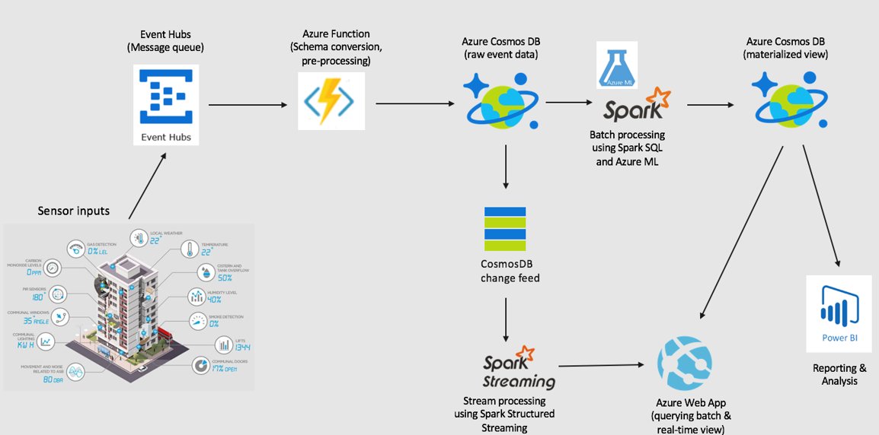
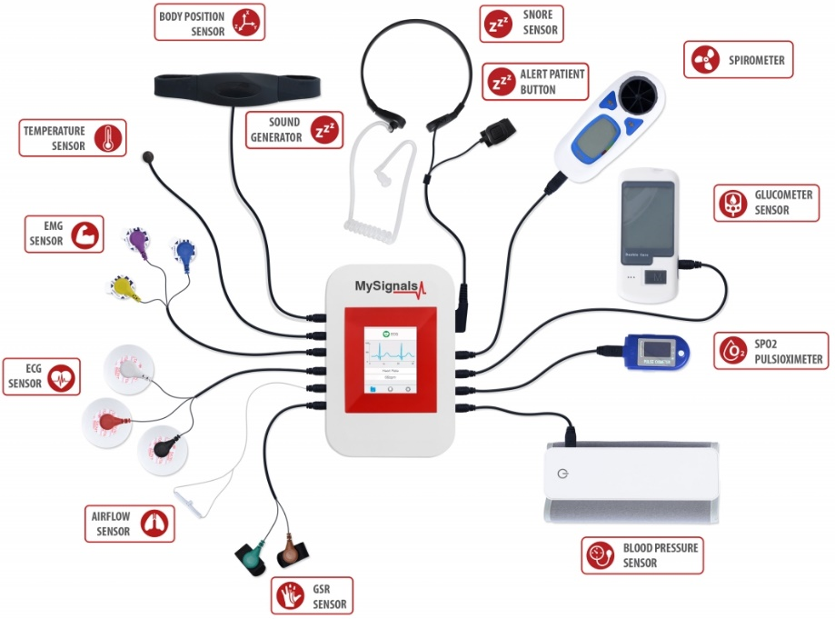

Streaming at scale using Azure Lambda Architecture with Change Feed

Slide 50

Lessons from the cloud…
Many choices, determine what serves you use case the best
Be agnostic, avoid affinity
Security in the cloud is a shared responsibility
Risks vary by implementation
Define protections that enable trust in the cloud
Adopt Zero Trust Networking Access policy.
Prefer cloud provider, native cloud products and services
Promote automation as early as possible
Don't forget cleanup!
Lessons Learned…
Be flexible, willing to adapt, and Be open-minded
Be pragmatic and honest with yourself
Plan for failure. If there is a chance of failure, fail fast
If you don't find success, start over. Anticipate the unexpected
Mistakes must be acceptable. Sometimes it takes several attempts
Resist the urge to haste – you may miss important opportunities
Keep emotions in check. Emotions or stress affect our thinking and judgment
Take notes and record progress when you’re working in uncharted territory

Slide 51
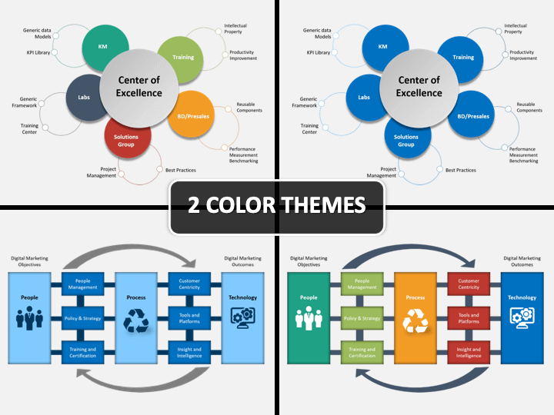

Slide 52

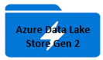
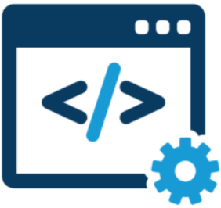


Data source types
Authentication types
Database
Kafka
MQ
HttpBasic
OAuth
SSL/TLS
SFTP
Data Sources
Read
Poster
To be invoked
Database
SFTP
Kafka
MQ
Web API
MLLP
SQL Database
NoSQL Database
Text file
Audio file
Image file
Video file
Messages posting
Messages posting
SOAP
JSON/XML
HL7
Extraction Layer
Extractor
Listener
Invoker
Standardization (Mapping)
Refinement
Enrichment
Data Stores
DS1
DS2

Slide 53
SQL Server Data Migration conceptual view
Configure
Define source endpoint(s), login credentials, and login protocol
Define target endpoint(s), login credentials, and login protocol
Extract
Using source endpoint(s) and credentials, extract source data
If requires preparation, enrichment, save it in a temporary storage
Refine & Enrich
Replace NULL values, provide missing values
Provide additional data, if required, e.g., 3rd party data
Define data source elements mapping to the target data elements
Map
Based on mapping defined in the configuration file, map source elements to target elements
Save
Save the result set from the mapping step to the target data source(s) using target data source information specified in the configuration file
Provide data type conversion if required

Slide 54
SQL Server Data Migration detailed
Requirements:
A configuration file is strongly recommended.
The configuration can be XML or JSON (preferred) based.
Data source(s) endpoint(s), AuthN and AuthZ credentials and login protocol for each data source should be defined in the configuration file
The login process will vary by platform, language and operating system, e.g., ODBC, JDBC, ADO.Net, SQL Server Native Client, Apache Spark Connector, Managed Service Identity (MSI) for Azure SQL Server, etc.
If the data requires cleansing/enrichment, store it in a temporary storage, such as a temp. table or a dataframe, etc.
Mapping between source data elements and target data elements should be defined in the configuration file. If possible, data types should also be defined in mapping as well.
There could be more than one data source and more than one target data source. Be sure to count for those scenarios.
Data Source
Data Source: It is the source of the data that needs to be extracted, prepared and migrated to the destination. There could be one or more data sources. Each data source will require access validation using login protocol, endpoint and login credentials.
Authenticate & Authorize
Extract
Extract: Upon successful validation of AuthN and AuthZ, extract data based on specified criteria. Store the result set in a temporary storage. It could be a temp table, a dataframe, etc.
Data Preparation
Data Preparation: This is a conditional step. The result set created in the previous step may require cleansing, refinement and/or enrichment. Refinement could be handling null values, supply missing values, etc. It may also require enrichment, e.g., add some external data to make result set more meaningful. This step may also require data type conversion for source data elements to be compatible with the target data elements
Enrich
Refine
3rd Party Data Source
Map
Map: In this step the source data elements are mapped to the target data source elements. The mapping is described in a configuration file. Based on the settings in the configuration file, the source to target data elements are mapped.
Target Data Source
Target Data Source: This is final delivery point for the data. There could be one or more target data source(s). It may be persisted in one or more database(s) or it could be fed into some other data pipeline.

Slide 55


SQL Server Data Migration detailed
Requirements:
A configuration file is strongly recommended.
The configuration can be XML or JSON (preferred) based.
Data source(s) endpoint(s), AuthN and AuthZ credentials and login protocol for each data source should be defined in the configuration file
The login process will vary by platform, language and operating system, e.g., ODBC, JDBC, ADO.Net, SQL Server Native Client, Apache Spark Connector, Managed Service Identity (MSI) for Azure SQL Server, etc.
If the data requires cleansing/enrichment, store it in a temporary storage, such as a temp. table or a dataframe, etc.
Mapping between source data elements and target data elements should be defined in the configuration file. If possible, data types should also be defined in mapping as well.
There could be more than one data source and more than one target data source. Be sure to count for those scenarios.
Optionally, you can also use Azure Data Factory for more complex use cases. It’s scale-out capability can handle any velocity and volume of data.
Data Source
Data Source: It is the source of the data that needs to be extracted, prepared and migrated to the destination. There could be one or more data sources. Each data source will require access validation using login protocol, endpoint and login credentials.
Authenticate & Authorize
Extract
Extract: Upon successful validation of AuthN and AuthZ, extract data based on specified criteria. Store the result set in a temporary storage. It could be a temp table, a dataframe, etc.. Optionally, you can also use Azure Data Factory, is a cloud-based data integration service, that automates the movement and transformation of data. It can connect to 90+ data sources in a standardized way, relieving you of the data connection complexity.
3rd Party Data Source
Data Preparation
Enrich
Refine
Data Preparation: This is a conditional step. The result set created in the previous step may require cleansing, refinement and/or enrichment. Refinement could be handling null values, supply missing values, etc. It may also require enrichment, e.g., add some external data to make result set more meaningful. This step may also require data type conversion for source data elements to be compatible with the target data elements. Azure Data Factory, a cloud ETL service for scale-out serverless data integration and transformation. It offers a code-free UI for intuitive authoring and single-pane-of-glass monitoring and management. Existing SSIS packages can also be run on Azure Data Factory.
Map
Map: In this step the source data elements are mapped to the target data source elements. The mapping is described in a configuration file. Based on the settings in the configuration file, the source to target data elements are mapped. Azure Data Factory copy activity does visual schema and data type mapping from source data to target data store when executing the data copy.
Target Data Stores
DS1
DS2
Target Data Source: This is final delivery point for the data. There could be one or more target data source(s). It may be persisted in one or more database(s) or it could be fed into some other data pipeline.

Slide 56
POC Plan
Create source SQL database
Create target database (e.g., Azure SQL Datawarehouse)
Create configuration file (JSON format)
Specify source info.
Endpoint
Login Id
Password
Login protocol
Specify target info.
Endpoint
Login Id
Password
Login protocol
Map source
Source element name → target element name
Source element type → target element type
Create a Jupyter (Python) notebook
Read data
Fill values (Nulls, empty, etc.)
Enrich data (read additional 3rd party data
Perform necessary data type conversion
Map source to target
Save data in target

Slide 57
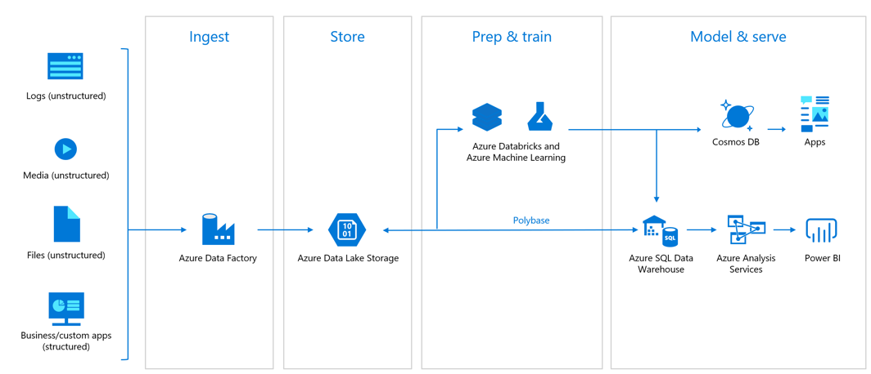
Azure Databricks - Overview
Azure Databricks is a fast, easy, and collaborative Apache Spark-based analytics service. For a big data pipeline, the data (raw or structured) is ingested into Azure through Azure Data Factory in batches, or streamed near real-time using Kafka, Event Hub, or IoT Hub. It’s in-memory processing and a novel data structure to reach processing speeds that are orders of magnitude faster than MapReduce.
You can use Event Hubs on it; run SQL like (SparkSQL/Azure Databricks) queries on it. You can also use time slice windows -
tumbling window(fixed-sized, non-overlapping and contiguous time intervals)
hopping window(scheduled overlapping windows)
sliding window (outputs events only for those points in time when the content of the window actually changes - when an event entered or exits the window
The output from which can be fed into Machine Learning, AI, BI, and stored in a number of datastores such as, AzureSQL, HBase, Azure Data Lake, Azure Blob and so on
Enables insights generation from all data and AI solution.
You can set up the environment in minutes, auto-scale and collaborate on shared objects to promote productivity.
Databricks supports Python, Scala, R, Java and SQL. In addition, data science frameworks, such as, TensorFlow, PyTorch, and Scikit-learn are supported as well.
You can quickly standup fast and optimized Apache Spark environment.
It has interactive workspace with built-in support for popular tools, languages, and frameworks makes its adoption easy.
ML on big data with native Azure Machine Learning integration.
High-performance modern data warehousing with Synapse
Leverage autoscaling and auto-termination to improve TCO.
Azure Databricks Architecture view

Slide 58
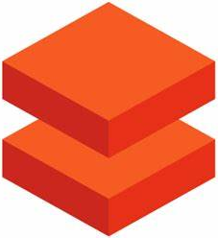
Azure Databricks Features
Optimized Apache Spark environment - provides the latest versions of Apache Spark to seamlessly integrate with open source libraries. Set up clusters quickly in a fully managed Apache Spark environment with global scale and availability. Optimized clusters are set up, configured, and fine-tuned to ensure reliability and performance with no need for monitoring. Autoscaling and auto-termination improves the TCO.
Azure ML compliments Azure Databricks - enables data scientists identify suitable algorithms and hyperparameters faster. Enables DevOps for ML for simplified management, monitoring, and updating of ML models; deploy models from the cloud and the edge; a central registry for experiments, machine learning pipelines, and models at the enterprise level.
Managed Mlflow - manages ML lifecycle. Accessible natively from Azure Databricks environment and leverage Azure Active Directory for authentication. Track experiments by automatically recording parameters, results, code, and data; package machine learning code
Modern data warehousing – the DW in the cloud provides unmatched performance and scalability. You can combine data at any scale, and get insights through analytical dashboards and operational reports. Automate data movement using Azure Data Factory, load data into ADLS Gen 2, transform and cleanse using Azure Databricks.
Security and compliance - Native integration with Azure Active Directory for role-based access control. Secure architectures without compromising on compliance using configurable virtual networks. Fine-grained user permissions for Azure Databricks notebooks, clusters, jobs, and data.
Shared workspace and common languages – collaborate on shared projects. Supports languages such as, Python, Scala, R, and SQL. Version control of notebooks with GitHub and Azure DevOps.
Data Engineering Light - enables customers to run batch applications on managed Apache Spark. Geared toward simple, non-critical workloads that don’t need the performance, autoscaling, and Data Analytics workloads.
Quick machine learning on big data - advanced automated ML capabilities using the integrated Azure ML to quickly identify suitable algorithms and hyperparameters. Provides simplified management, monitoring, and updating of machine learning models deployed from the cloud to the edge. And a central registry for experiments, machine learning pipelines, and models.
Big data analytics and AI with Apache Spark

Slide 59




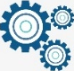
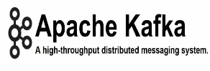
Databricks - Reference Architecture
Source layer
Aggregate layer
Analyze layer
Publish layer
Data Consumption
Source Layer
VPN
Data Access
IP Firewall
Curated Layer
Publish Layer
VPN
Encounter
Ingest
Store
Azure Databricks
Cleansed/Enriched
EMS
ODBC/JDBC
Databricks
(Spark)
API
Azure SQL DW & SQL DB
PC
(VPN)
Lab
Pharmacy
Azure Data Factory V2
ADLS
Web Service
Files
ADLS
Membership
Cosmos DB
Kafka Event Capture
Invoke ML Service, when required
Azure API
APP
Smart
Phone
Billing
Express Route
Event hub- Capture
Transform/Aggregate
Web Services
GIS
Insights/Models
Azure API
Management
Downstream Data Systems
Semi-structured
Azure API Mgmt.
Azure Event Hub
Azure ML
Databricks
ML Flow
Azure Analysis Services
Un-structured
Azure Functions
Azure Cognitive Services
Real Time Data
Logic APP
IOT
Audit balance and control
Batch
Authentication, Authorization, Accounting &
Data Protection
Secure Key Management
Orchestration
Monitoring and Administration
Azure DevOps
Real-time
Azure Active Directory
Data Factory
Key Vault
Azure Monitor

Slide 60
Lifecycle of a Machine Learning project
Business Understanding
Domain knowledge
Data Acquisition & Understanding
Data source(s)
Modeling
Feature engineering
Deployment
Package model
Use case understanding
Data Pipeline
Data cleansing, preparation, wrangling , exploration, visualization
Environment
Feature selection
Model creation
Model training
Model evaluation
Model optimization
Deploy model
Scoring/ Predictions
Performance monitoring
Requirements understanding
Even though all 4 phases of a successful ML project are important. However, in this context, we’ll focus on the Modeling and Deployment phases only. The remaining phases, Business Understanding and Data Acquisition & Understanding are assumed to be completed elsewhere.
List of available ML modules on Azure ML Studio (classic):
Data input and output modules - Enter Data Manually, Export Data, Import Data, Load Trained Model, and Unpack Zipped Datasets
Data transformation modules – Data Transformation - Filter, Learning with Counts, Data Transformation - Manipulation, Data Transformation - Sample and Split, Data Transformation - Scale and Reduce
Machine learning algorithms - Anomaly Detection, Text analytics modules, Classification, Clustering, and Regression
Vowpal Wabbit support makes it easy to use this scalable platform
OpenCV library - Import Images and Pretrained Cascade Image Classification
Time series analysis - Time Series Anomaly Detection
Statistical modules - Apply Math Operation, Compute Elementary Statistics, Compute Linear Correlation, Evaluate Probability Function, Replace Discrete Values, Summarize Data, and Test Hypothesis Using t-Test
There is a huge ML models library available at https://gallery.azure.ai/ for you to leverage. For example, the following list of models is available in Healthcare (https://gallery.azure.ai/industries/healthcare) domain: Predicting Length of Stay in Hospitals; Binary Classification: Breast cancer detection; Heart Disease Prediction; Predicting breast cancer using data from AzureML. The list is growing rapidly.
In addition, there is a sizable repository of Azure ML with Jupyter notebooks located at https://github.com/azure/machinelearningnotebooks.
Azure Machine Learning is more focused on the process and algorithms rather than tools. Azure Machine leaning Studio (classic) and Python are most frequently used Machine Learning tools (in Azure). And, Numpy, Pandas, MatPlotib, Seaborn, and Scikit-learn are the most frequently used Machine Learning libraries.

Slide 61
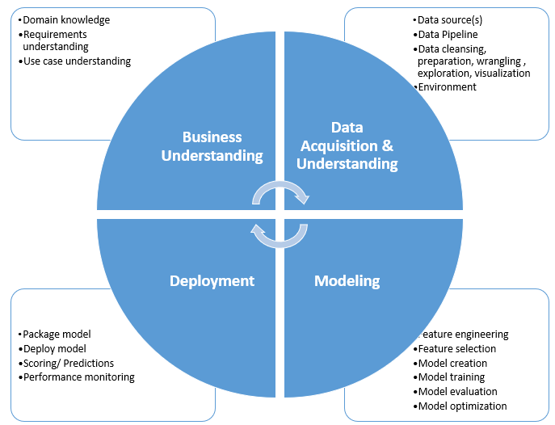
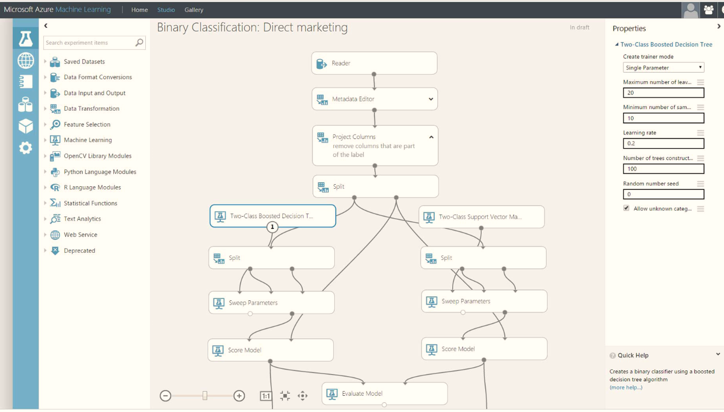




Modeling
Feature engineering is the extraction of additional relevant features from raw data using techniques such as, data mining to increase the predictive power of the learning algorithm. It requires domain knowledge, prior experience, EDA, and ML modeling feedback. The feature engineering process is:
Create hypothesis for features;
Decide what features to create;
Create features;
Validate how the features work with the model;
Improve features if necessary;
Repeat this process until satisfactory features are created.
Feature Engineering Lifecycle
Feature selection selects the key subset of original data features in an attempt to reduce the dimensionality of the training problem to use in building of an analytical model. It helps narrow the field of data to the most valuable inputs, which reduces noise and improves training performance. Feature selection serves two main purposes:
Increase classification accuracy by eliminating irrelevant, redundant, or highly correlated features.
Decrease the number of features, which makes the model training process inefficient. Efficiency is important for learners that are expensive to train such as support vector machines.
Some useful Feature election techniques are Pearson Correlation, Heatmap, and Extra Tree Classifier, Filter-based feature selection, Fisher Linear Discriminant Analysis, and Permutation Feature Importance.

Slide 62




Modeling
Model creation – the easiest way to start building ML models is to use the Azure Machine Learning designer . It is a visual tool that offers drop and drop of many features, decision trees, and parameters.
You can also use Python to create the machine model using scripting. This option should only be used when you’re well versed in ML model creation. You can model, test and evaluate locally. When satisfied, you can create a deployment package and deploy it.
Model training – is the validation of the hypothesis. It involves providing an ML algorithm with training data to learn from. The training data must contain the correct answer, which is known as a target or target attribute. The learning algorithm finds patterns in the training data that map the input data attributes to the target. It outputs an ML model that captures these patterns. You need to specify: training data source, name of the data attribute that contains the target to be predicted, required data transformation instructions, and training parameters to control the learning algorithm. During the training process, ML automatically selects the correct learning algorithm, based on the type of target in the training data source. Typically, machine learning algorithms accept parameters that can be used to control certain properties of the training process and of the resulting ML model known as training parameters. You can set these parameters using the Azure ML Studio, API, or CLI. Some useful techniques to train the model are: error/cost function, exhaustive search, genetic algorithms, simulated annealing, gradient descent, assumption vs. performance, loss function for linear model, accuracy validation, confusion matrix, data splitting, cross-validation, decision tree, and random forest to train the model.

Slide 63


Modeling
Model evaluation – involves Model accuracy, precision, recall, ROC, and AUC for classification tasks
Model accuracy - can be defined as the ratio of correctly classified samples to the total number of samples
Precision - the number of true positives divided by the total number of elements labeled as belonging to the positive class
Recall - the number of true positives divided by the total number of elements that actually belong to the positive class and false negatives, items not labeled as the positive class but should have been.
ROC - a graphical plot that shows the diagnostic ability of a binary classifier system as its discrimination threshold is varied. Created by plotting the true positive rate (TPR) against the false positive rate (FPR).
AUC - a two-dimensional depiction of classifier performance. We may want to reduce ROC performance to a single scalar value representing expected performance. its value will always be between 0 and 1.0; no realistic classifier should have an AUC less than 0.5
Model optimization – is the most essential part of machine learning algorithms. It starts with defining some kind of loss function/cost function and ends with minimizing it using one or the other optimization routine. Model optimization uses linear programming to optimize a process. The analytical methods make use of differential calculus in locating the optimum solution. The choice of optimization algorithm can make a difference between getting a good accuracy in hours or days. The optimization process is: evaluate performance, optimize parameters, evaluate results. The following are most commonly used techniques - Continuous Optimization versus Discrete Optimization, Unconstrained Optimization versus Constrained Optimization, None, One or Many Objectives, Hyperparameter Tuning, Deterministic Optimization versus Stochastic Optimization, AdaGrad Optimization, and RMSProp Optimization.

Slide 64





Deployment
Package model – After the ML model has been created and fully tested in the local environment. It is ready to be deployed into the production environment. The following are the recommended steps:
Register the model - A registered model is a logical container for one or more files that make up the model. Machine learning models are registered in the Azure Machine Learning workspace.
Prepare to deploy - package assets, usage, compute target and dependencies in a package, label it, and save it in a repository.
Deploy the model to the compute target.
Deploy model – is integration of the model into an existing production environment. Flask is a popular package for ML model deployment. Cloud platforms such as, AWS and Azure offer many choices that can connect with a number of technologies. Azure ML model can be deployed on compute targets such as, local compute, an Azure Machine Learning compute instance, an Azure Container Instance (ACI), an Azure Kubernetes Service (AKS) cluster, an Azure Function, or an Internet of Things (IoT) module. It uses containers as a deployment mechanism, packaging the model and the code to use it as an image that can be deployed to a container in the chosen target. To deploy a model as a service, do the following:
Register a trained model in your Azure Machine Learning workspace.
Define an Inference Configuration - define the script and environment for the service. It consists of: a. A script to load the model and return predictions for submitted data; b. An environment in which the script will be run.
Define a Deployment Configuration - Configure the target compute. Define the deployment configuration to set target-specific compute specification for the containerized deployment
Deploy the Model – Deploy the model to the target compute. For more information on deploying models with Azure Machine Learning, see Deploy models with Azure Machine Learning.

Slide 65


Deployment
Scoring/Predictions– pertains the measurement of effectiveness of an ML model. There are several ways to measure the accuracy and prediction of a model. For example:
Confusion matrix - measure the performance of the model (TP, TN, FN, FP)
Accuracy - the total number of correct predictions divided by the total number of datasets. Accuracy should be observed over a period of time, e.g., one month; verify output, if output accuracy is less acceptable, start over. If output is inaccurate, you need collect more data; you may have to change algorithm
Precision – True Positive/(True Positive + False Positive)
Recall - True Positive /(True Positive +False negative)
f1 score = 2X Precision X Recall / Precision + Recall. f1 Score is a better metric for imbalanced datasets. f1 score is the metric to quantify the performance
Model score & error - use Scikit-learn library to find out the scores of ML Models and choose the algorithm with a higher score to predict output. You can calculate errors such as mean absolute error and mean squared error and try to minimize them to improve models.
Performance monitoring– It is essential to monitor the model output for performance and accuracy. The data and environment may change quickly or over time. If model performs below expected level, then you would have to reselect data and you may even have to switch to a different algorithm to get the accepted level of accuracy and performance. You can collect data from and monitor ML models deployed to web service endpoints in Azure Kubernetes Service (AKS) or Azure Container Instances (ACI) by enabling Azure Application Insights. You can an endpoint's input data and response; Request rates, response times, and failure rates
Dependency rates, response times, and failure rates and Exceptions

Slide 66





Roles in Machine Learning
Business Analyst
Data Engineer,
Data Analyst
Software Engineer, Data Engineer
Data Scientist (Advisory)
Software Engineer
(Data Visualization)
Data Scientist

Slide 67

Roles and Responsibilities in a Machine Learning project
Business Analyst
Gather requirements
A liaison between Data Analysts and business stakeholders
Run stakeholder meetings
Make Presentations
Software Engineer
Help Data Scientist write scripts
Ensure standards and policies are followed
Implement access controls and policies
Create deployment packages
Help deployment teams with the ML service deployment
Help preserve source code, binaries and versions
Data Analyst
Determine data quality
Help select appropriate data set
Help curate data
Visualize data
Data Engineer
Identify data source(s)
Extract & reshape data
Create data access & storage services
Select appropriate storage type and tier
Build data pipeline
Data Scientist
Help data identification & curation
Model building
Model testing
Model optimization
Help model deployment

Slide 68
Roles and Skill Competencies in a Machine Learning project
Software Engineer
Help Data Scientist write scripts
Ensure standards and policies are followed
Appropriate access controls and policies are used
Create deployment packages
Help deployment teams with the ML service deployment
Help preserve source code, binaries and versions
Business Analyst
Business domain knowledge
Effective business requirements gathering
Run stakeholder meetings
Good presentation skills
Great communication skills
Always in-sync with stakeholders and product owners
Data Analyst
Determine what data will be required
Clear communication skills
Some programming skills, e.g., SQL
Competent in data visualization tools, e.g., Power BI, Tableau, Matplotlib, etc.
The more data knowledge, the better Data Analyst
Data Scientist
An applied mathematics, statistics along with computer science
Ability to choose appropriate machine learning algorithms, train them, and devise accuracy test plans
Programming languages such as, Python, Scala, R, SQL
Interact with Data Analysts to cultivate the desired insights
Data analysis to help businesses use their data assets
Expert in data storytelling to layout complex results and observations in laymen’s terms
Data Engineer
Programming background, possibly a computer science degree, and languages such as, Python, Scala, Java, SQL
Create data pipelines at scale, integrating big data technologies
Deep understanding of data technologies and frameworks and integration with data pipelines
Work with teams responsible for clusters, DevOps, and DataOps
Implement machine learning algorithms chosen by data scientist

Slide 69

Thoughts from the practitioners
The items depicted below are thoughts and experiences shared by Machine Learning practitioners. They should provide pragmatic guidance for the successful creation and adoption of a ML/AI COE.
Domain expertise is essential
Business analyst, data analyst, data scientist and data engineer need to work together
Cross training is beneficial
Business analyst and data scientist work on data enrichment process
80% time is spent on data preparation (Data cleansing, curation, preparation, wrangling , exploration, visualization)
Data engineer does the data cleansing, wrangling and enrichment
Data Scientist provides the Math and creates modeling
Software engineering creates deployment and service endpoints
Expect to deal with structured data (e.g., database data, spreadsheet), semi-structured data (e.g., XML, JSON) and/or unstructured data (log files, audio, video, social media)
Data curation skills such as, handle Null values, handle imbalances, remove Noise, cleanse data, normalize data, and categorize data are essential for feature engineering and selection
Most frequently used well-known Math concepts: Linear Algebra; Matrix algebra and eigenvalues; Calculus for Data Science; Derivatives and gradients; Gradient Descent, and a simple neural network
Some well-known Math packages: Pandas - for data wrangling, NumPy - for large, multi-dimensional arrays, matrices, and high-level mathematical functions, SciPy - for linear algebra, interpolation, optimization, integration, and statistics, Matplotlib- for an object-oriented API for embedding plots into applications, Seaborn for data visualization , Scikit Learn - for supervised and unsupervised learning algorithms, and TensorFlow - to create large-scale neural networks
To create a model - Adopt the 5E’s model approach - Engage, Explore, Explain, Elaborate, and evaluate
Use data access

Slide 70
Thoughts from the practitioners (cont’d)
Use regression and classification to make predictions
Create Prototype‐based models
Apply model to data and validate
Start with the internal data - cleanse, wrangle and enrich data
Compare old model to new model
Compare different models
The input data can be biased
Prevent model bias - use a representative dataset, choose the right model, perform real-world testing on real-world datasets; Use multiple people to code the data, have participants review results, use disparate data sources, check for alternative explanations, review findings with peers
Deploy - AWS cloud, API Gateway control, Direct Connect, Django, Flask, Azure Runbooks, ML Studio
Implement Machine Learning as a service to provide real-time predictions
Implement Stream analytics and machine learning capabilities to provide recommendations and detect fraud/issues in real-time
Lessons Learned
Business owners and product owners are critical
Good data is very important - data cleansing, preparation and enrichment are critical
Must have knowledge to create models and the judgment to use the right models
Leverage automatic model tuning using tools such as, Autopiler, AWS SageMaker, Azure HyperParameters
Data engineers to need to ensure data pipeline with appropriate roadmaps

Slide 71

Databricks Connectors
You can access a wide variety of data sources in Databricks. A list of available data sources is provided below. Some data sources are directly supported in Databricks Runtime; others require that you create a Databricks and install it in a cluster. Many also include a notebook that demonstrates how to use the data source to read and write data.
Amazon Redshift
Amazon S3
Amazon S3 Select
Azure Blob Storage
Azure Data Lake Storage Gen1
Azure Data Lake Storage Gen2
Azure Cosmos DB
Azure SQL Data Warehouse
SQL Databases using JDBC
Binary File
Cassandra
Couchbase
ElasticSearch
Image
Hive Tables
MLflow Experiment
MongoDB
Neo4j
Oracle
Avro Files
CSV Files
JSON Files
LZO Compressed Files
Parquet Files
Redis
Riak Time Series
Snowflake
Zip Files

Slide 72


